Slide 1
Adversarial attacks with primer into optimization
Textbook seminar
Presenter : Kim Sunki

Slide 2
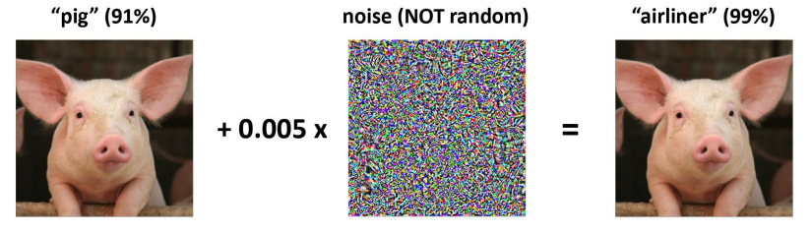
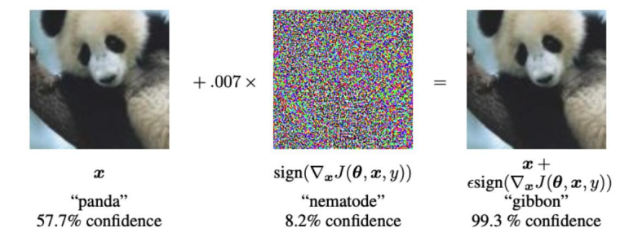
Adversarial attack
Notes:
사람 눈에는 거의 인식 불가능한 노이즈를 원본 이미지에 더해 분류기가 다른 클래스로 오분류하도록 하는 공격기법

Slide 3
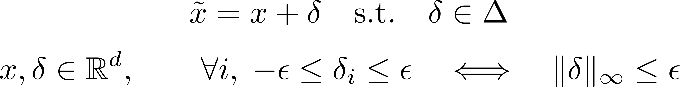
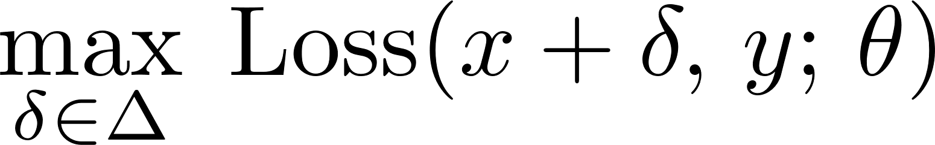
Adversarial examples
An adversarial example is a perturbed input $\tilde{ x}$, with $x≈\tilde{x}$, such that $\text{Loss}\left(\tilde{x} , y , θ\right)$ is high

Slide 4
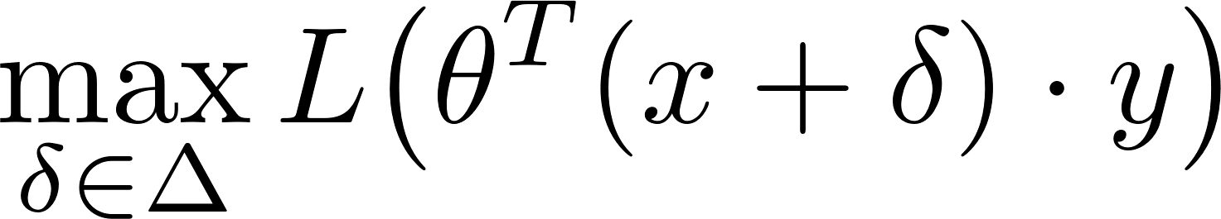
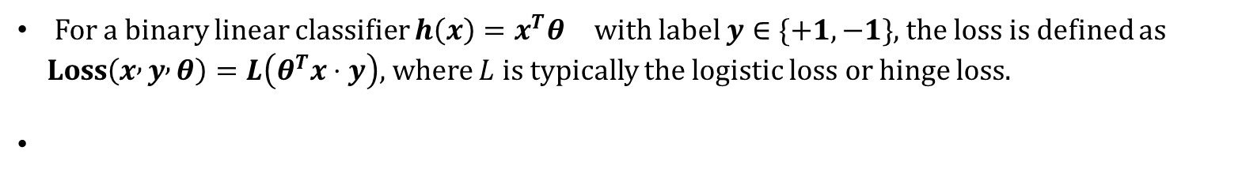
Binary Linear Classifier
For a binary linear classifier $h\left(x\right)=x^{T}θ$ with label $y∈\{+1, −1\}$, the loss is defined as
$\text{Loss}\left(x , y , θ\right)=L\left(θ^{T}x⋅y\right)$, where $L$ is typically the logistic loss or hinge loss.

Slide 5
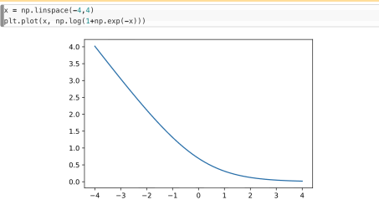
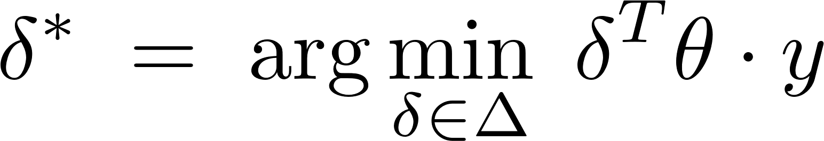
Binary Linear Classifiers
Since $L$ is a monotonically decreasing function, maximizing $L$ is equivalent to minimizing its argument

Slide 6
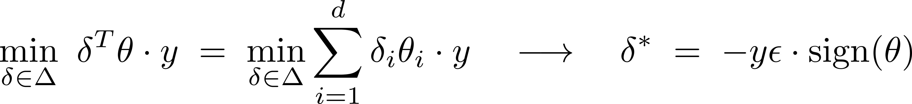
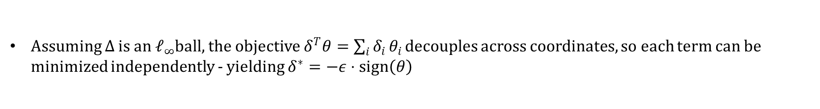
Binary Linear Classifiers
Assuming $Δ$ is an $ℓ_{∞}$ball, the objective $δ^{T}θ=\sum_{i}{δ_{i}}θ_{i}$ decouples across coordinates, so each term can be minimized independently - yielding $δ^{∗}=−ε⋅\text{sign}\left(θ\right)$

Slide 7
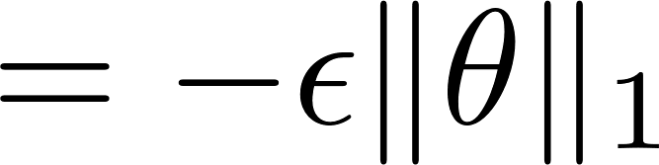
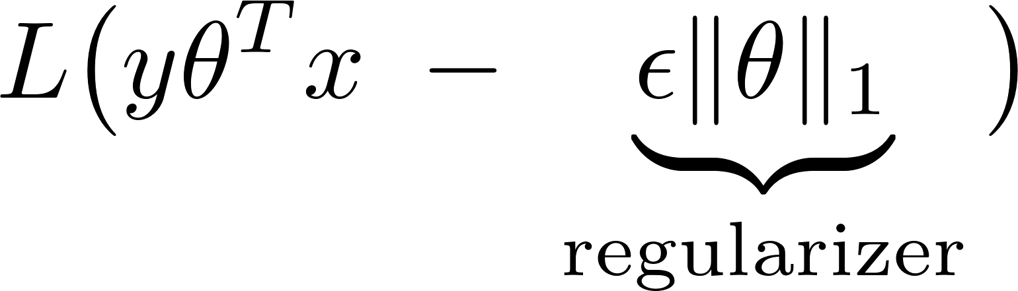
Binary Linear Classifiers

Slide 8
Binary Linear Classifiers

Slide 9
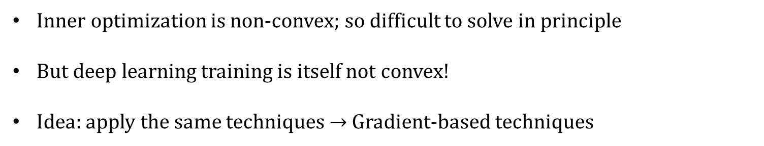
Deep Networks
Inner optimization is non-convex; so difficult to solve in principle
But deep learning training is itself not convex!
Idea: apply the same techniques $→$Gradient-based techniques

Slide 10
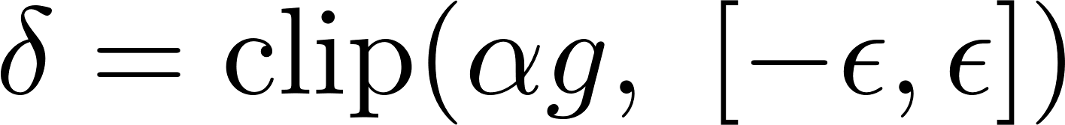
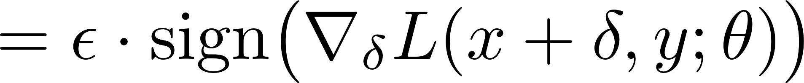
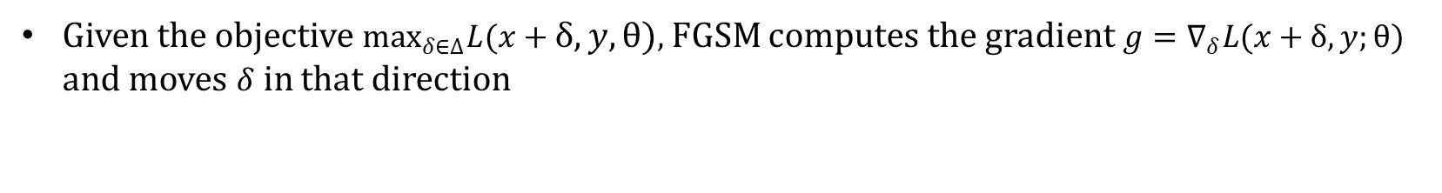
Fast Gradient Sign Method
Given the objective $\max_{δ∈Δ}L(x+δ, y,θ)$, FGSM computes the gradient $g=∇_{δ}L(x+δ, y;θ)$ and moves $δ$ in that direction
The idea is to "project" $αg$ to lie within $Δ$. If $α$ is chosen large, the clipped result saturates to $±ε$on every coordinate - which is $ε⋅\text{sign}\left(g\right)$.

Slide 11
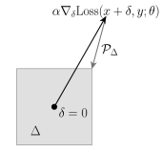
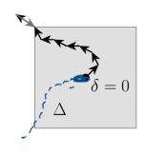
Projected Gradient Descent
Repeat FGSM iterations several times
Could also restart with multiple random seeds
FGSM
PGD

Slide 12
Targeted attacks
An untargeted attack only requires the model to misclassify the input into any wrong class, while a targeted attack pushes the model toward a specific target label $\tilde{y}$ chosen by the attacker

Slide 13

Black-box attacks
Previous algorithms assume access to the weights - Called “white box” attacks
What if we do not have access to the model weights - We cannot compute the gradients of L with respect to $δ$
First Idea: The principle of transfer!
Train a substitute model
Attack substitute model with white-box attacks
Second Idea: zero-th order attacks
Gradient estimation :
Some tricks on reducing number of function calls - Like coordinate descent, Random Vector …

Slide 14
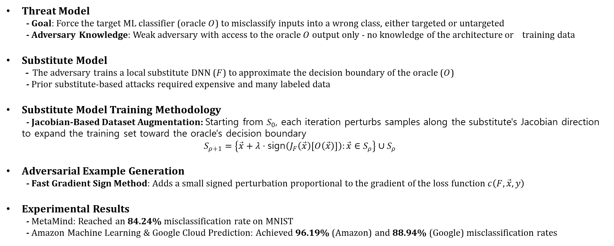
Practical black-box attacks against machine learning
N. Papernot et al. In Proceedings of the 2017 ACM on Asia Conference on Computer and Communications Security
Threat Model - Goal: Force the target ML classifier (oracle $O$) to misclassify inputs into a wrong class, either targeted or untargeted - Adversary Knowledge: Weak adversary with access to the oracle $O$ output only - no knowledge of the architecture or training data
Substitute Model - The adversary trains a local substitute DNN ($F$) to approximate the decision boundary of the oracle ($O$) - Prior substitute-based attacks required expensive and many labeled data
Substitute Model Training Methodology - Jacobian-Based Dataset Augmentation: Starting from $S_{0}$, each iteration perturbs samples along the substitute's Jacobian direction to expand the training set toward the oracle's decision boundary $S_{ρ+1}=\left\{\vec{x}+λ⋅\text{s}\text{i}\text{gn}\left(J_{F}\left(\vec{x}\right)\left[O\left(\vec{x}\right)\right]\right):\vec{x}∈S_{ρ}\right\}∪S_{ρ}$
Adversarial Example Generation - Fast Gradient Sign Method: Adds a small signed perturbation proportional to the gradient of the loss function $c\left(F,\vec{x},y\right)$
Experimental Results - MetaMind: Reached an 84.24% misclassification rate on MNIST - Amazon Machine Learning & Google Cloud Prediction: Achieved 96.19% (Amazon) and 88.94% (Google) misclassification rates

